Slide 1
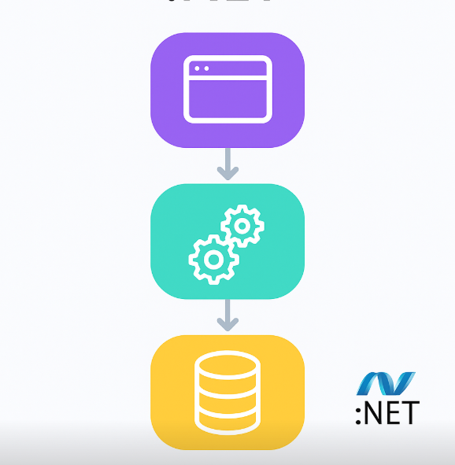
Application Architecture with .NET-Class6 6. Deployment and Cloud Integration
Instructor: Anthony Jesus Portilla Cano MCT

Slide 2
Agenda
Deploying .NET Applications to Azure.
Implementing CI/CD Pipelines.
Monitoring and Logging Strategies.

Slide 3
• Deploying .NET Applications to Azure

Slide 4
Deploying .NET Applications to Azure
Overview of Azure deployment options
Deploying with Azure App Service and Azure Web App for Containers
Dockerizing .NET applications for the cloud

Slide 5
Implementing CI/CD Pipelines

Slide 6
Implementing CI/CD Pipelines
Introduction to Continuous Integration and Continuous Deployment (CI/CD)
Automating builds, tests, and deployments with GitHub Actions
Integrating Azure Container Registry (ACR) and Azure Web Apps in the pipeline

Slide 7
Monitoring and Logging Strategies

Slide 8
Monitoring and Logging Strategies
Importance of monitoring and observability in cloud applications
Integrating Application Insights for distributed tracing and logging
Custom logging, metrics, and alerting in Azure

Slide 9
SUMMARY
Seamless deployment of .NET applications to Azure using App Service and Docker containers enables scalable, cloud-native solutions.
CI/CD pipelines (e.g., with GitHub Actions) automate building, testing, and deploying, ensuring rapid and reliable delivery to the cloud.
Comprehensive monitoring and logging with Application Insights provides real-time visibility, diagnostics, and proactive alerting for cloud applications.

Slide 10
Let's move on to the demo

